Slide 1
Technology Intensive II
10 classes
5 Projects + Participation
1 credit

Slide 2
What is this class about?
This is a user experience course.
The purpose is to expand upon the concepts that are core to the profession that you were introduced to in Technology Intensive I.

Slide 3
Who are you?

Slide 4
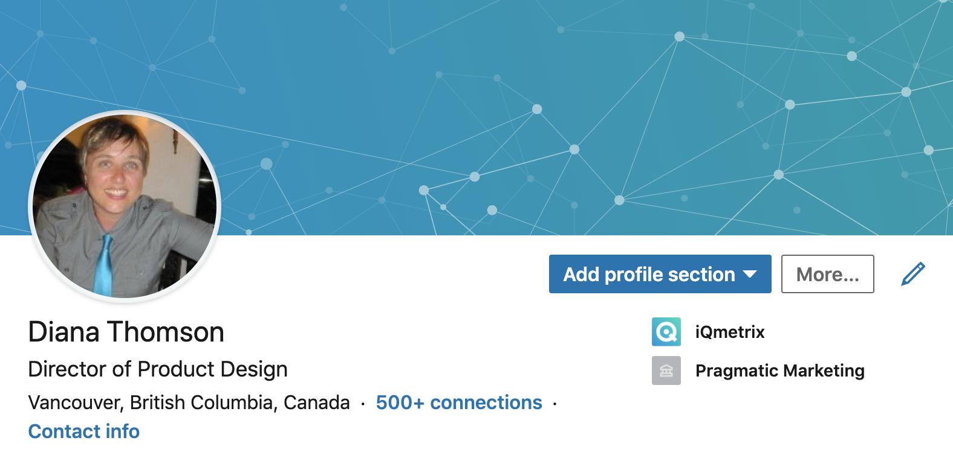

Slide 5
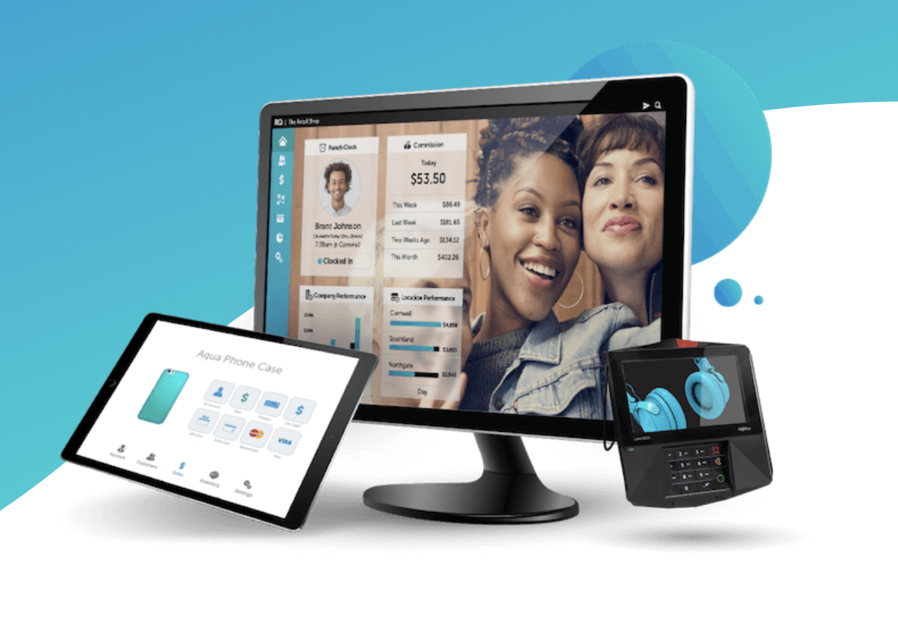
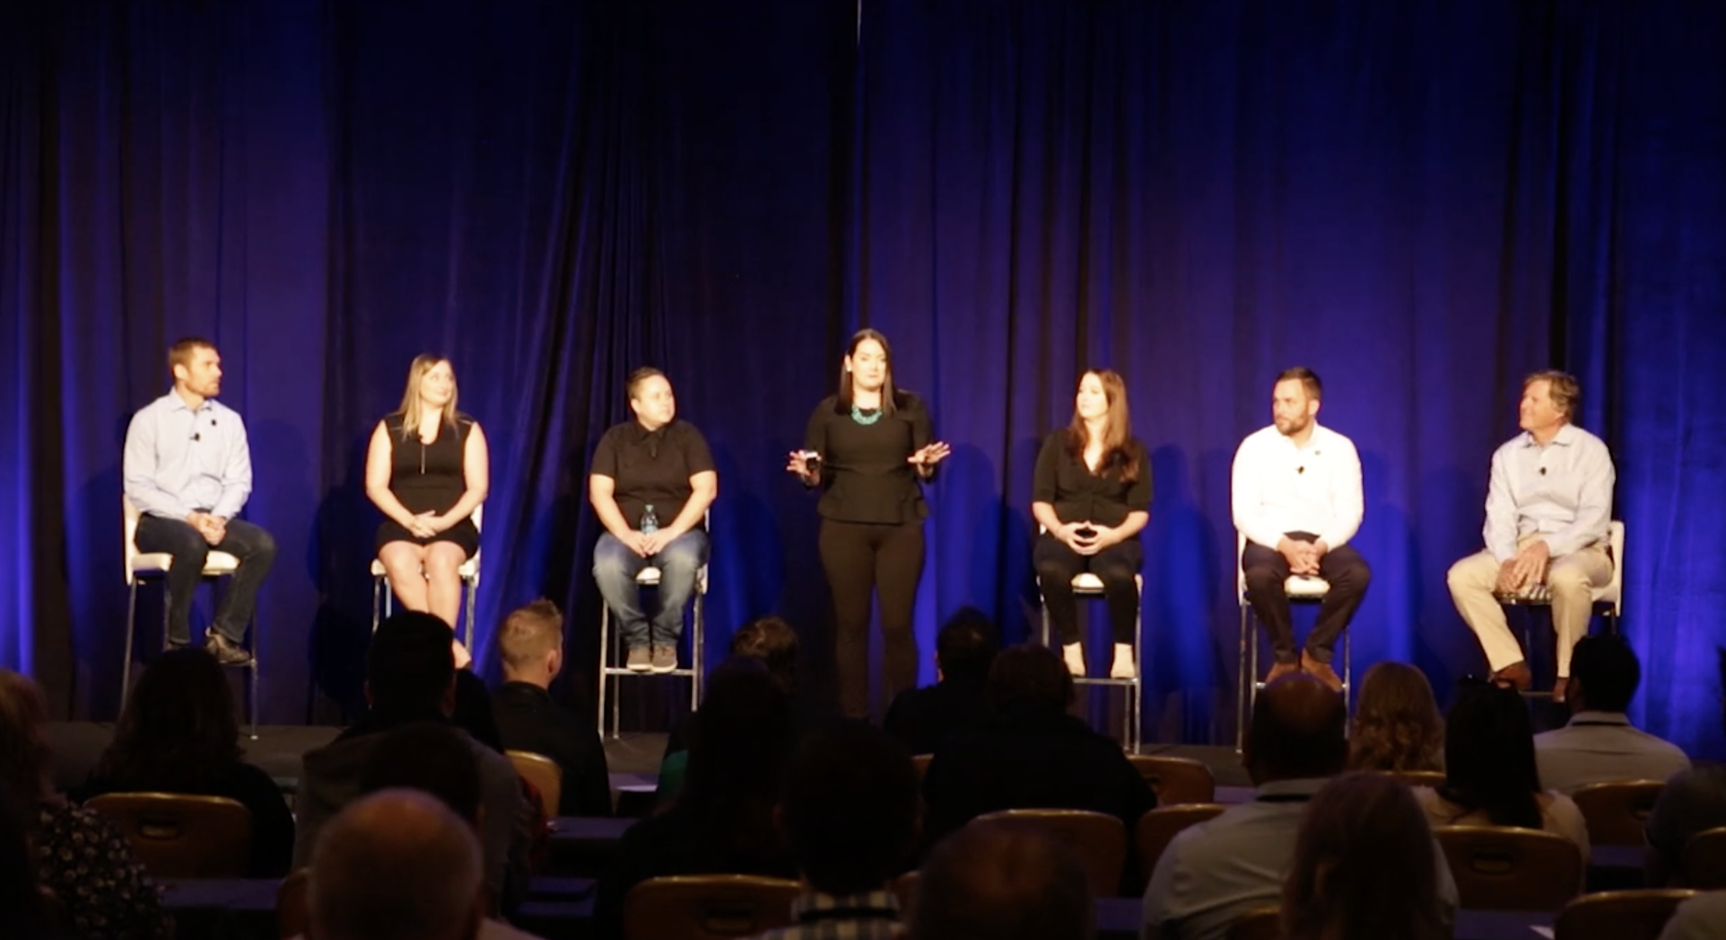
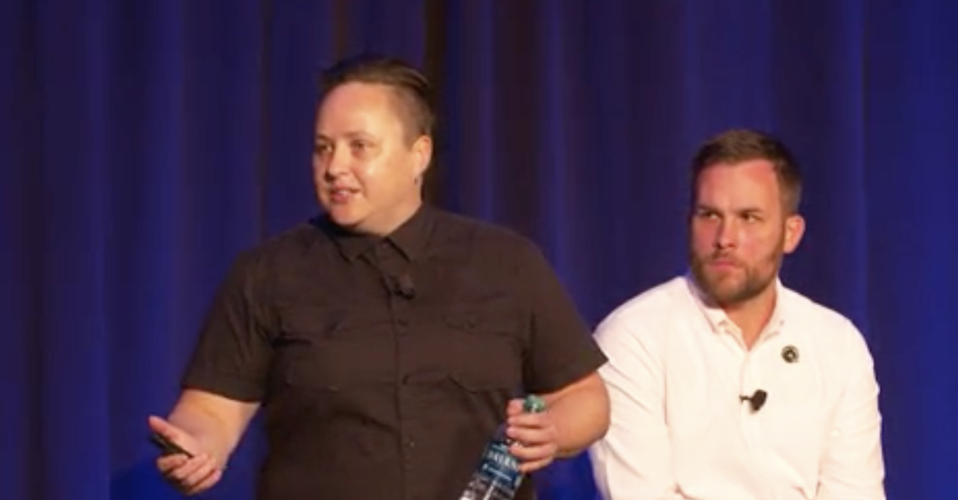
Today – Director of Product Design

Slide 6
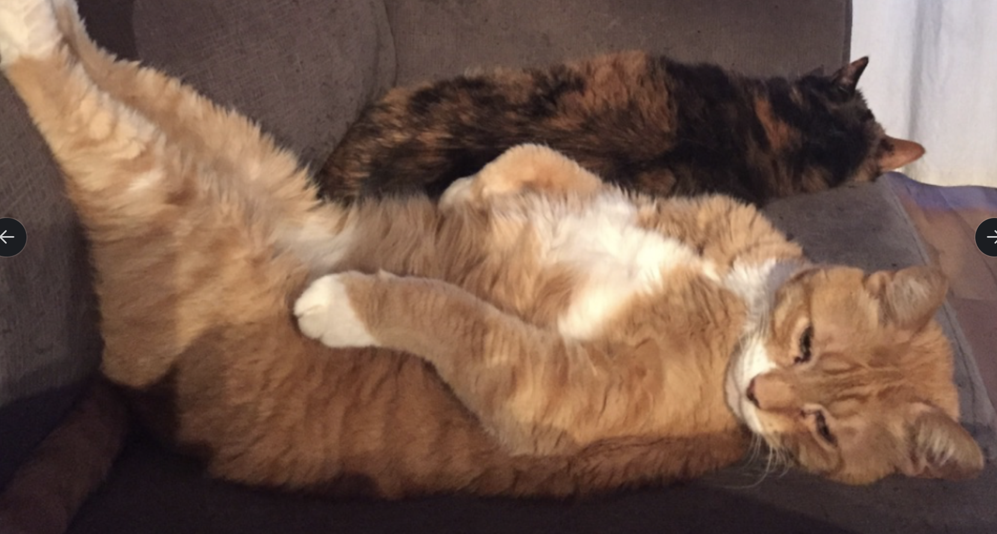
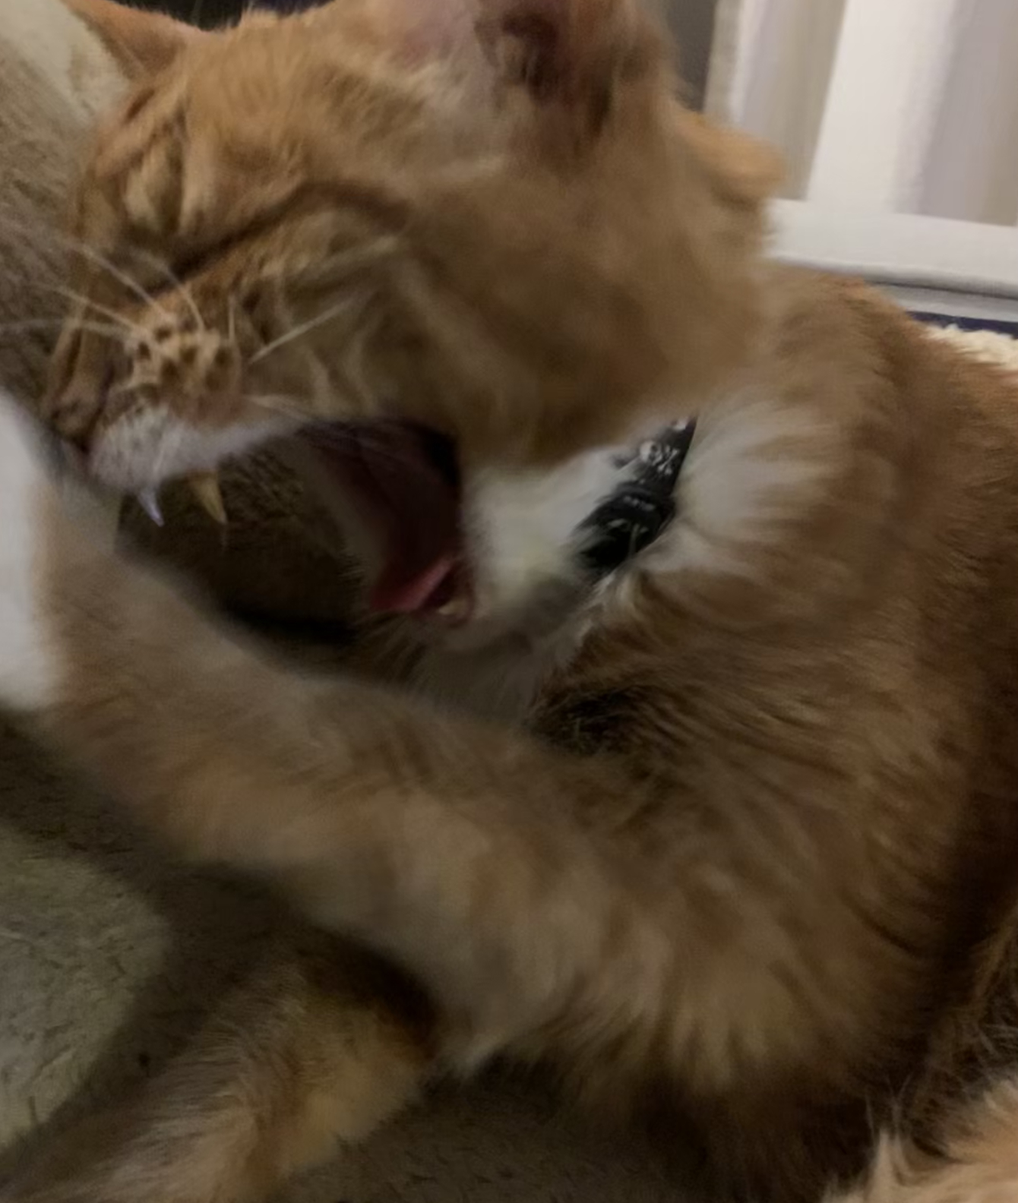
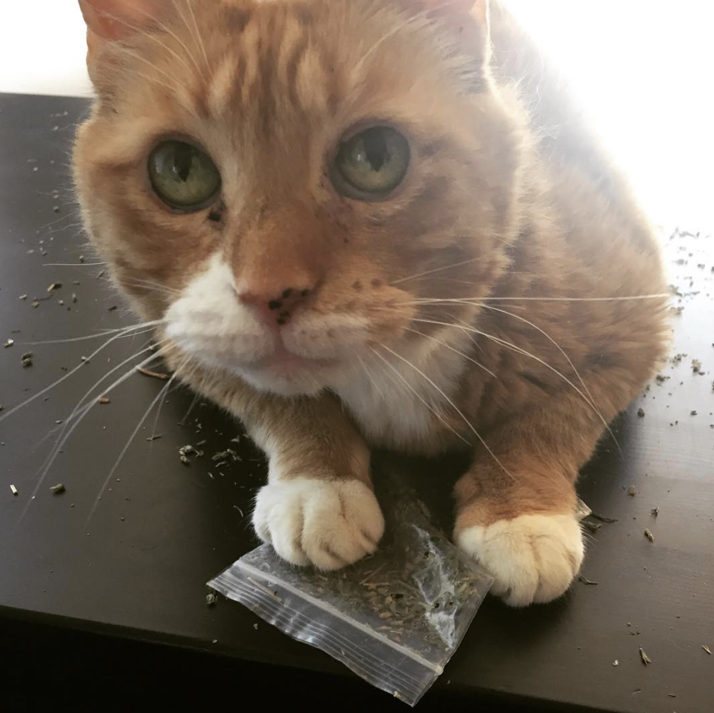
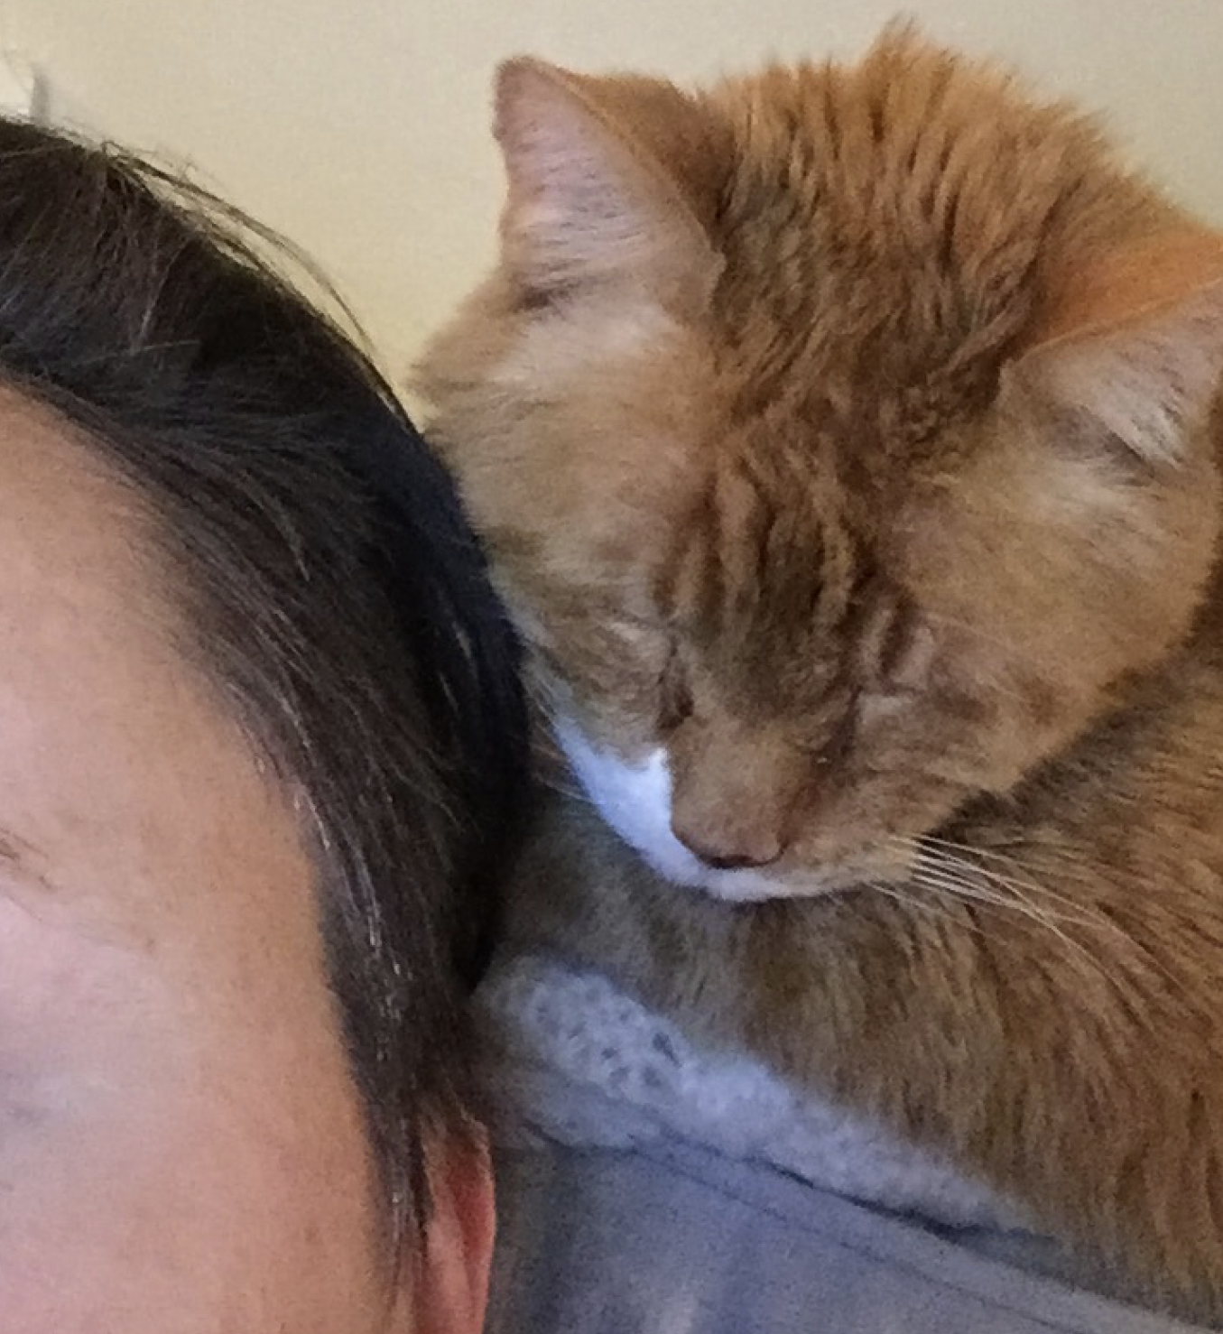

Slide 7
What you will learn?
UX Best Practices
Organizing information
User research
UX Deliverables
Design Guides & Systems
Advanced Sketch infrastructure (Components, Symbols etc.)
Interactive prototypes

Slide 8
Week- | Content/Lecture | Assignments | Due
Week 1 | Course outline, overview of class project (building a prototype), and review of tools. Demo: Build a user persona | 1. User Persona | 12 pm Week 2
Week 2 | UX Design Understanding UX strategy, goals, tasks and content Demo: User journeys and site maps | 2. User Journey & Site Map | 12 pm Week 3
Week 3 | UX Design, cont. Building wireframes, best practices, content layout, and responsive design Demo: Using Sketch for midfi wireframes and setting up your grid | 3. Clickable Wireframes | 12 pm Week 6
Week 4 | UX Design, cont. Building wireframes, cont. Demo: Introduction to Sketch symbols
Week 5 | UX Design, cont. Taking wireframes to InVision Demo: Using InVision to build clickable wireframes from Sketch files
Week 6 | UI Design Art Direction Demo: Building Style Tiles, Moodboards | 4. Design System | 12 pm Week 9
Week 7 | UI Design, cont. Building components Demo: UI components – principles and best practices
Week 8 | UI Design, cont. Building components. Demo: UI design systems
Week 9 | InVision Prototyping Demo: Using Invision to build a clickable prototype, and using the Inspect tool to view and understand CSS and HTML | 5. Prototype | 9 am Week 10
Week 10 | InVision Prototyping, cont. Viewing final projects

Slide 9
Project 1 (User Persona) | 5%
Project 2 (User Journey & Site Map) | 5%
Project 3 (Clickable Wireframes) | 20%
Project 4 (Design System) | 30%
Project 5 (Prototype) | 30%
Participation | 10%
Total | 100%

Slide 10
Concepts vs. aesthetics

Slide 11
What you should expect from me?

Slide 12
What do I expect from you?

Slide 13
Logistics and housekeeping.

